Slide 1
USA IMMIGRATION PROJECT02
RAUL FLORES
JUAN RAMON FELIX
TIAGO LOPES
BARBARA SANCHEZ

Slide 2
MAIN OBJECTIVES
Overview of USA Migration from Latin America countries.
Locate the most popular cities for residence.
Review variables that give us more insights on the status and group of people per state.

Slide 3
RESEARCH PROCESS
Define the scope of the analysis :
How immigrants behave on each of the states.
Demographic analysis.
Focus on LatinAmerican countries.
Identify data sources:
US Census
Migration Policy Institute
The Immigration Center
BEA
Identify the tool frameworks and resources to create the storytelling.
D3 Gallery.
Mapbox.
Plotly.
AOS library (NEW).

Slide 4
ETL PROCESS
EXTRACT:
United States Census : We use this database for getting the information on country of origin, number of immigrants per state, age, income, and other economic variables. Source of information :https://www.census.gov/data/tables/time-series/demo/geographic-mobility/historic.html.
TRANSFORM:
On Jupyter Notebook - Filter codes for country and state to create a data frame with all the data.
Matrix with percentage of immigrants on each country and state.
Json file with immigrant numbers per state and country for scatter plot.
LOAD:
Postgres loading: SQL structure.
Load from Pandas to Postgres.

Slide 5
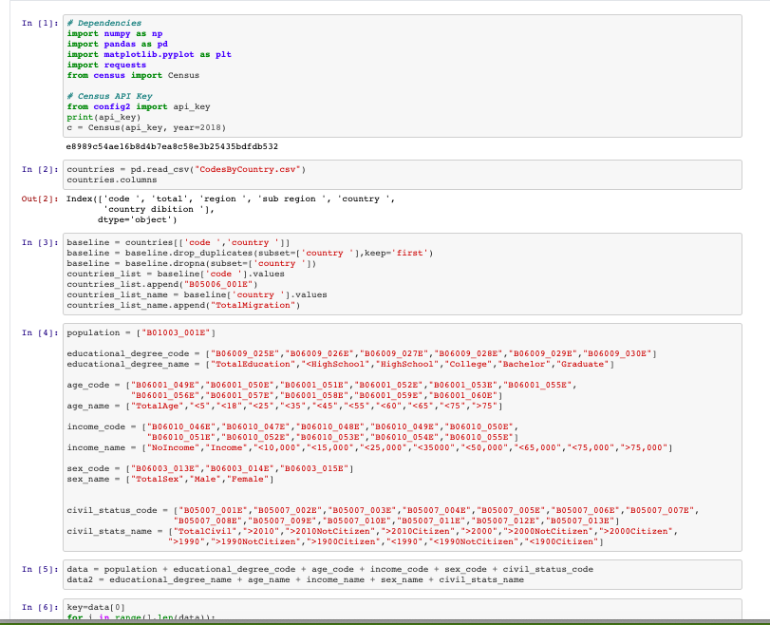
BACKEND OVERVIEW

Slide 6
FRONTEND OVERVIEW

Slide 7
CONCLUSION
Central American immigration is greater than South America.
Mexico is an outlier compare to Latin countries.
Caribbean islands tend to migrate to the East Coast.
Central American migrants are more attractive to USA Hispanic origin states.
Mexico & El Salvador are the top countries of birth from immigrants.
California, Florida & Texas are the most popular states.

Slide 8
LEARNINGS
Consolidation into a final endpoint takes time and complexity on merge.
User interface and frontend is a complete project.
ETL process is the biggest challenge.
Deployment and production is an extra challenge.

